Slide 1





Network Intrusion Detection and Prevention in Organization
Mohammed Al Madhi and Daniel Kearl

Slide 2
Glossary
Overview of Network Security and IDPS
Basics of Network Vulnerability
Threats to Network Security
Detection and Prevention
Recovery
References
Conclusion

Slide 3
Overview
Network attacks.
Methods are improving, and it’s cheaper and easier to launch network attacks.
Attacks are mainly focused on organizations
Organizations are suffering from these attacks as they are the main target for network attacks.
Competitive intelligence: attacker wants to know the secrets to about the organization’s financials, products, services or other business secrets.
Harming the organization: attacker intends to harm or disable the organization’ network operations.
Intrusion Detection and Prevention System
Monitors analyzes computer network traffics and notifies the network administrator in an event of an attack.
Notes:
Mohammed

Slide 4


Threats to Network Security
Network Attacks on Organizations
Phishing:
Misleading e-mails, tricking someone into giving confidential information (like passwords and credit card information) on a fake web page or email form pretending to come from a legitimate
Ransomware:
Type of malware that will encrypt all your files on a Windows Operating System, which makes them inaccessible, then will have a screen displayed asking for money in return for a key that will unlock your files.
Notes:
Phishing: It is the act of tricking someone into giving confidential information (like passwords and credit card information) on a fake web page or email form pretending to come from a legitimate company (like their bank).

Slide 5
Network Attacks on Organizations Cont.
DoS/DDoS
Denial of Service (DoS): Massive number of packet sent from one location to a server, in which server becomes overloaded and crashes
DDoS: Massive number of packet get sent from multiple locations using bot computers to a server, in which the server becomes overloaded and crashes
Preventing DoS/DDoS Attacks
Invest in an Anti-DoS/DDoS tool which some of these tools are cloud based tools, some tools do come with a free option such as Cloudflare, but its highly recommended to choose the best plan for your organization to prevent these attacks.

Slide 6
Cont. Threats to Network Security
DNS Spoofing
An attack in which the cyber attacker tricks your computer into thinking its going to a legitimate website but in fact it’s not, in which the attacker gains access to your DNS cache to steal your personal data/credentials.
Misconfiguration
System’s default account password is blank or leaving the organization’s network password unsecured.
Social Engineering
Commonly used technique by a social engineers is someone who poses as and IT staff and asks employees for their password in order to fix an issue with their account, an IT staff would never ask for an employee password in most cases.
Notes:
Packet/Network Sniffing are also known as packet analyzers are piece of hardware and or software that monitors traveling data over the networks, most organizations use these for legitimate purposes, although this can be used by an attacker to steal information from a network.
Domain Name Spoofing (DNS) Spoofing is an attack in which the cyber attacker tricks your computer into thinking its going to a legitimate website but its not, in which the attacker gains access to your DNS cache to steal your personal data/credentials if entered.

Slide 7
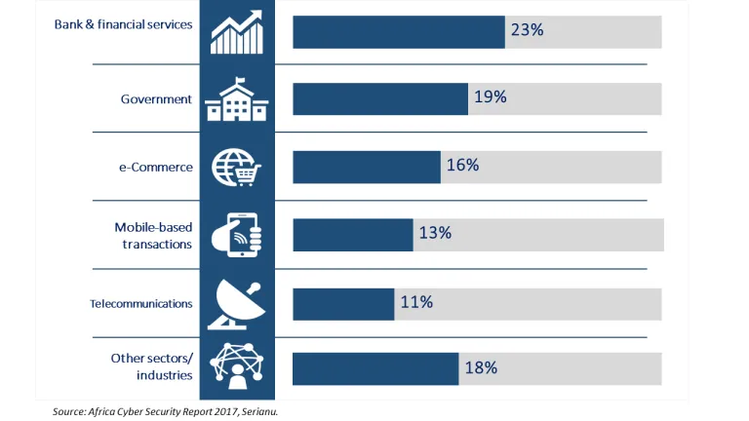
Industries affected

Slide 8
Detection and Prevention
Access Control
Access Control ensures that users have appropriate access that is designed to their job title, for example the organization’s security guards should not have access to the corporate Financial data.
Business Policy
Security Guidelines for user access, password requirements, confidentiality and the usage of their data.
Employees must accept the consequences for their misuse.

Slide 9
Detection and Prevention Cont.
Employee Training
Employees also need to understand the threats to network, make them aware and to prevent Phishing, Ransomware and Social Engineers as these are one of the biggest threat's employees face, with proper training the less chance of an employee to fall for these threats.

Slide 10





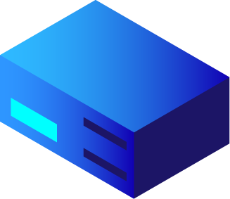



Recovery
Evaluation
Management
Planning
IR Plans
DR Plans
BCP
Decision Making

Slide 11

Thanks!
Any questions?

Slide 12
Sources
Industries affected:
https://www.brookings.edu/blog/africa-in-focus/2018/05/30/global-cybercrimes-and-weak-cybersecurity-threaten-businesses-in-africa/

Slide 13

Extra resources

Slide 14
SlidesCarnival icons are editable shapes. This means that you can:
Resize them without losing quality.
Change fill color and opacity.
Change line color, width and style.
Isn’t that nice? :) Examples:
Find more icons at slidescarnival.com/extra-free-resources-icons-and-maps

Slide 15
😉
You can also use any emoji as an icon! And of course it resizes without losing quality. How? Follow Google instructions https://twitter.com/googledocs/status/730087240156643328
✋👆👉👍👤👦👧👨👩👪💃🏃💑❤😂😉😋😒😭👶😸🐟🍒🍔💣📌📖🔨🎃🎈🎨🏈🏰🌏🔌🔑 and many more...

